Slide 1


DEPARTMENT OF COMPUTER SCIENCE AND ENGINEERING
20CS8504 - PROJECT WORK
END SEMESTER PRACTICAL EXAMINATION- APRIL / MAY - 2026
Batch No : 12
Date: 30.03.2026
Session: AN

Slide 2
GHOSTKEY: SECURE INTELLIGENT CLOUD STORAGE WITH CRYPTOGRAPHIC PROTECTION
Guide Name:
Mrs. V. KALPANA,M.E.,(Ph.D.,)
Team Members
KISHORE M – 811722104079
LOGESHWARAN P – 811722104083
MADHAVAN P - 811722104084

Slide 3
OBJECTIVE OF THE PROJECT
The system ensures that only authenticated users can upload, download, and share files through dynamic OTP verification.
All data is encrypted before being stored in the cloud, minimizing risks of unauthorized access and data breaches.
This approach improves confidentiality, integrity, and user trust while maintaining simplicity and efficiency.
GhostKey provides a reliable solution for safeguarding sensitive information in modern cloud environments.

Slide 4
INTRODUCTION
The growing reliance on cloud storage for personal and organizational data, ensuring privacy and security has become critical.
Conventional cloud storage systems often face risks such as unauthorized access, data breaches, and identity theft.
GhostKey addresses these concerns by integrating encryption techniques with One-Time Password (OTP)-driven authentication, ensuring that only verified users can access sensitive files.

Slide 5
LITERATURE SURVEY
TITLE | AUTHORS | PAPER GIST | TECHNOLOGY USED
A Two-Factor Authentication Mechanism Using a Novel OTP Generation Algorithm for Cloud Applications | R. Konwar, D. Jha, R. Agrawal, R. Purkayastha, I. Banerjee | IEEE | Two-Factor Authentication (2FA), OTP Generation Algorithm, Cloud Applications
Efficient Chaos Based Homomorphic Permutation and SPM-BOW Algorithm for Secure Image Storage and Retrieval in Cloud | Ishwarya R, Anitha Ramachandran | International Conference on Power, Energy, Control and Transmission Systems | Chaos-Based Encryption, Homomorphic Permutation, SPM-BOW Algorithm, Cloud Storage Security, Image Retrieval
Privacy Preserving File Sharing System | M. Lee, K. Chen | Elsevier | Encryption, Access Control
Secure File Sharing in Cloud | J. Smith, A. Kumar | Springer | RSA, Cloud Storage
AI Based Secure Data Storage in Cloud | R. Kumar, S. Singh | IEEE | Artificial Intelligence, Cloud Security

Slide 6
TITLE | AUTHORS | PAPER GIST | TECHNOLOGY USED
AI-Driven Secure Cloud File Sharing Using AES Encryption | R. Konda, S. Patel | IEEE | AES, SHA-256, Multi-Factor Authentication
Secure Data Sharing in Cloud Computing | K. Zhang, X. Wang | IEEE | Cloud Storage
Privacy-Preserving Data Sharing in Cloud | L. Liu, J. Li | Springer | RSA,Data Encryption
Blockchain Based Secure File Sharing System | A. Sharma, P. Gupta | Elsevier | Blockchain, Smart Contracts
Multi-Factor Authentication for Secure Cloud Systems | D. Patel, M. Shah | ACM | MFA, SHA-256, Access Control

Slide 7
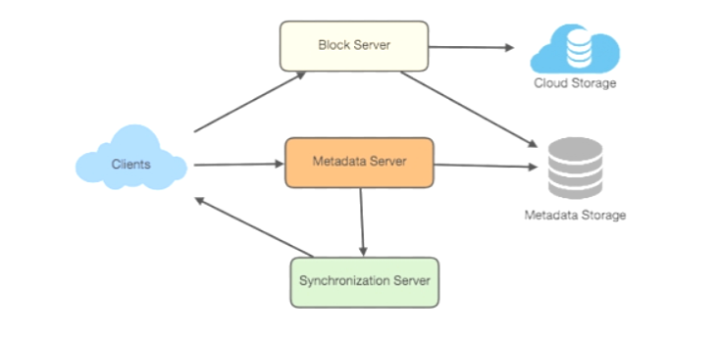
EXISTING SYSTEM

Slide 8
PROBLEMS IDENTIFIED
• Lack of secure file storage leading to data breaches. • Unauthorized access due to weak authentication systems. • Difficulty in safely sharing files over cloud platforms. • Absence of real-time monitoring for suspicious activities. • Risk of data loss and privacy issues in traditional systems.

Slide 9
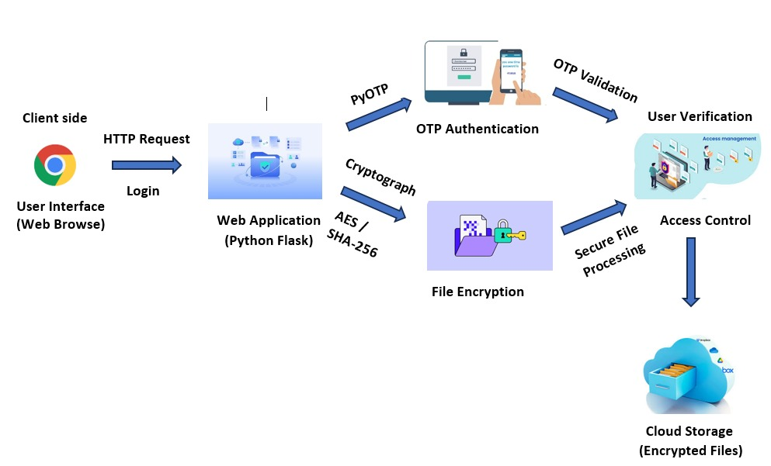
PROPOSED SYSTEM

Slide 10
SOFTWARE AND HARDWARE REQUIREMENTS
HARDWARE
Process: intel® core™ i9-14900k 3.20 ghz
Ram: 16 gb
Hard disk: 1 tb
SOFTWARE
Frontend: HTML, CSS
Backend: python
Framework : flask

Slide 11
MODULES
User Registration and Authentication
2. Dashboard Management
3. File Encryption and Decryption
4.secure cloud storage
5.File Sharing and Activity Monitoring

Slide 12

User Registration and Authentication
• Provides a secure web interface for users to manage files. • Allows user registration, login, and OTP-based authentication. • Validates user details and ensures secure account creation. • Ensures only authorized users can access the system after registration. • Provides password strength checking during registration.

Slide 13
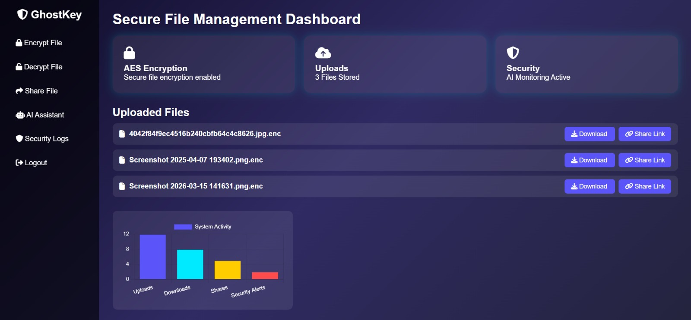
Dashboard Management
• Provides a centralized dashboard to manage all uploaded files. • Displays file details such as name, status, and actions. • Allows users to download and share files securely. • Shows system activity like uploads, downloads, and alerts. • Provides quick navigation to encryption, decryption, and sharing features.

Slide 14
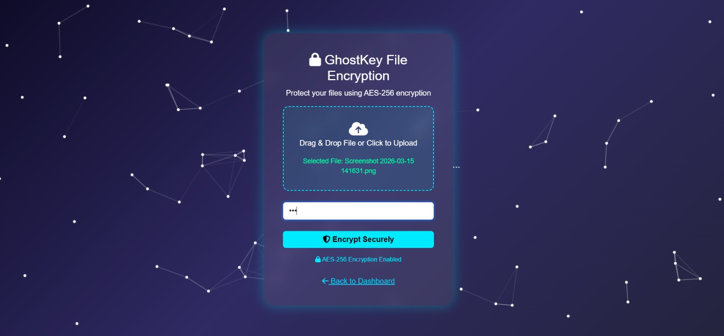
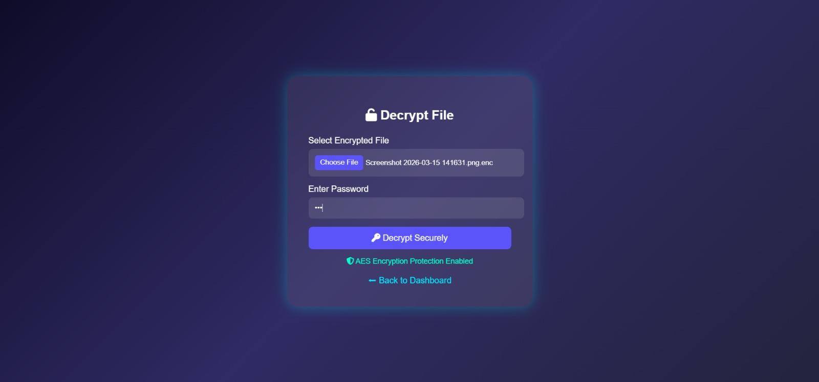
File Encryption and Decryption
Enables secure file encryption and decryption using AES-256 algorithm with password protection for enhanced data security.
Provides OTP-based protection for secure user authentication and file access.

Slide 15
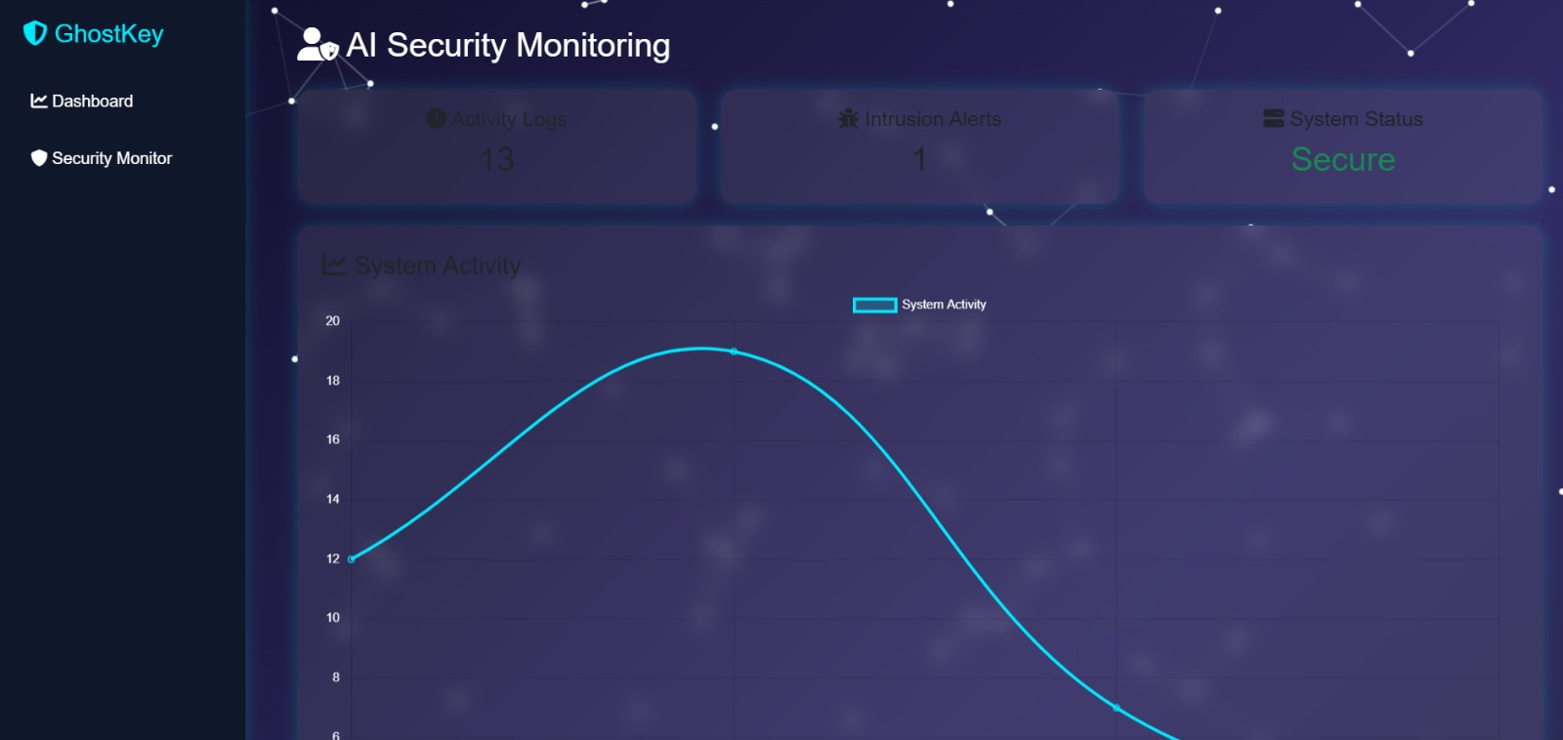
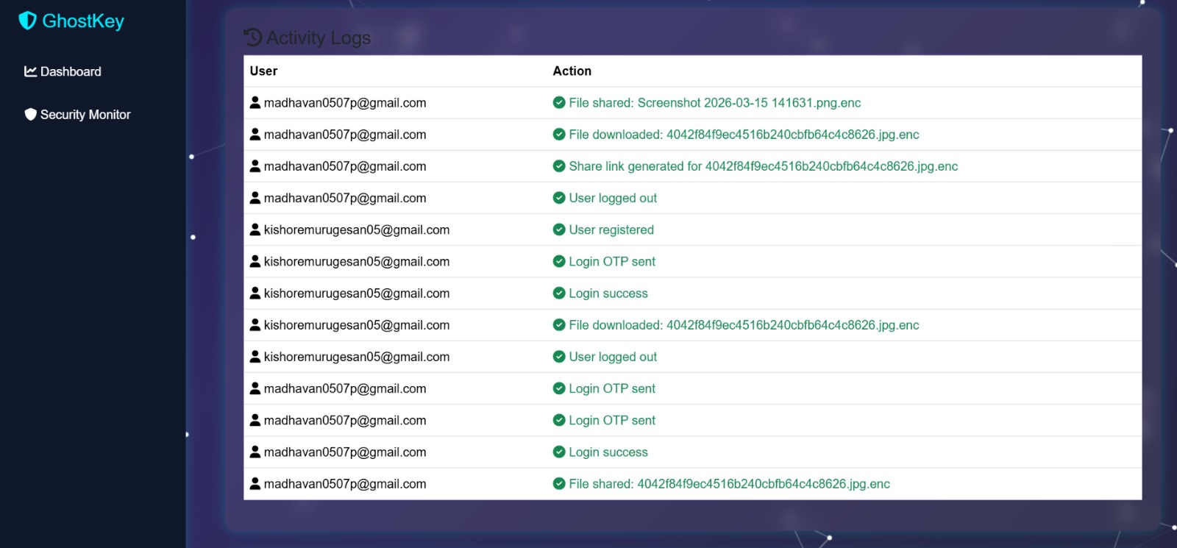
Secure Cloud Storage
• Displays real-time system activity and security monitoring through visual
charts. • Shows detailed user logs including uploads, downloads, login actions, and
alerts.

Slide 16
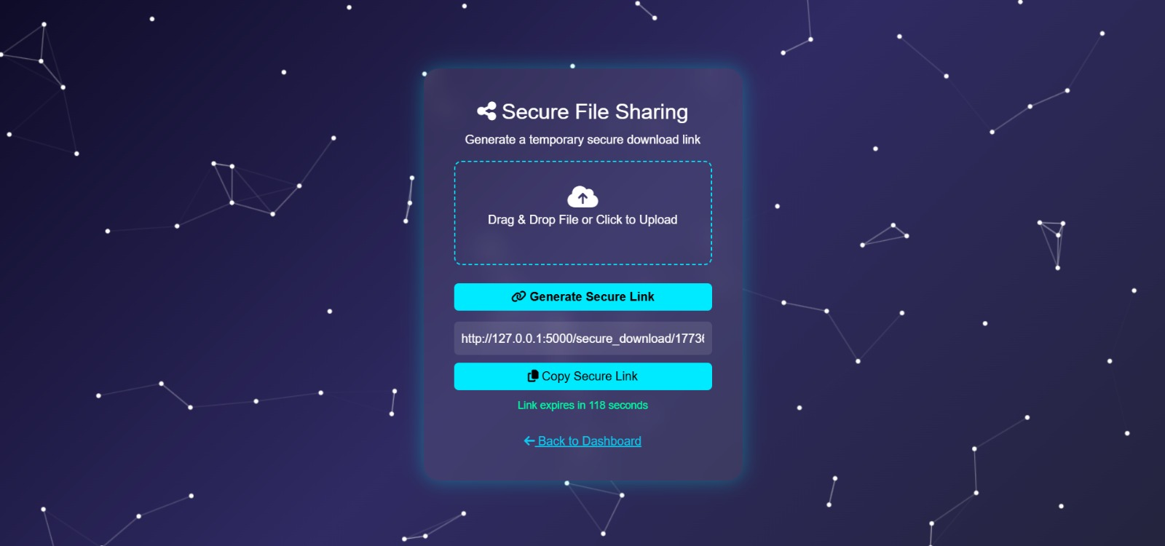
File Sharing and Activity Monitoring
• Displays real-time system activity using interactive charts and graphs. • Shows detailed user logs including login, upload, download, and sharing actions. • Monitors security alerts and detects suspicious activities. • Provides clear visualization of system performance and user behavior.

Slide 17
CONCLUSION
Ghost-Key is a secure cloud storage system that protects user data and privacy.It uses OTP-based authentication to ensure only authorized users can access files.
Files are protected using encryption, keeping data confidential and safe.The system includes access control and activity monitoring to track and manage user actions.
Secure File Sharing: Users can safely upload, store, and share files without compromising security.

Slide 18
FUTURE ENHANCEMENTS
Biometric Authentication (Fingerprint / Face recognition) for stronger security.
Machine Learning Detection to identify unusual activities or security threats.
Multi-Cloud Storage Support to improve reliability and backup.
Mobile App Integration for easier access from smartphones.
End-to-End Encryption to ensure data remains protected during storage and transfer.

